Slide 1


LITTER DETECTION ALGORITHM
Gregory Seda, Malialosa Tapule, Andrew Zhang,
Christopher Banci, Vanessa Joerns, Katherine Mayo
Notes:
Greg

Slide 2




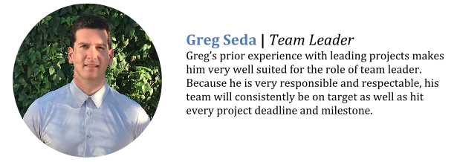

MEET THE TEAM
Greg Seda
Team Leader
Malia Tapule
Project Manager
Andrew Zhang
Programmer
Chris Banci
Programmer
Vanessa Joerns
Programmer
Katherine Mayo
Documentation Specialist
Notes:
Greg

Slide 3
OBJECTIVE
fixIT proposes to design an algorithm that takes images from Google Streets and identifies the presence of litter.
THE ALGORITHM
● Will utilize the Google Streets API
● Will display the street image with
outlines of the litter that is visible along
with percentages based on the
accuracy
Notes:
Greg

Slide 4
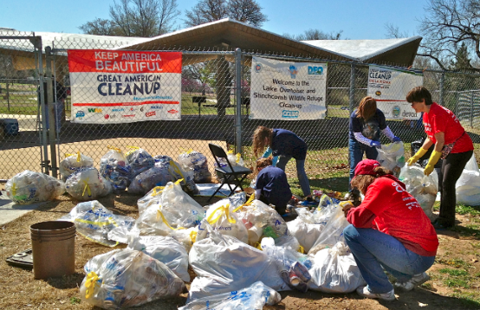
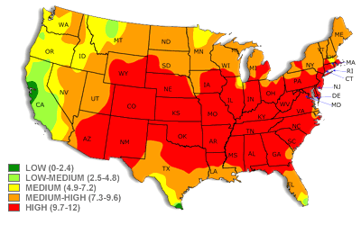
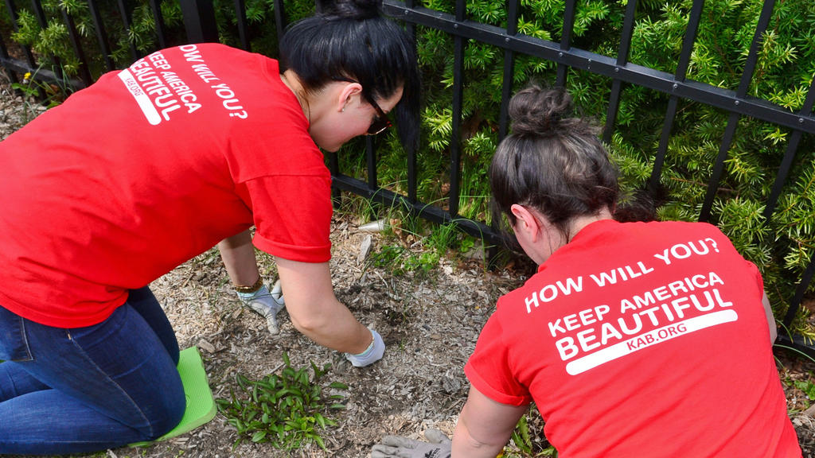
PURPOSE
Keep America Beautiful aims to create a cleaner America and hosts community clean up events across the country.
However, their events are done without any strong statistical data.
With the data that could be taken from our algorithm, they will be able to identify the locations in the US that need clean up the most.
Notes:
Greg

Slide 5
PROJECT MANAGEMENT

Slide 6
TIMELINE
Jan | Feb | Mar | Apr | May
Phase 0: Research
01/30/18
01/30/18
Phase 1: JAD 1
02/07/18
02/07/18
Phase 2: JAD 2
02/22/18
Phase 3: Prototype 1
03/15/18
03/15/18
Phase 4: Prototype 2
04/12/18
Phase 5: Final
05/15/18
05/15/18
Notes:
Kathy

Slide 7
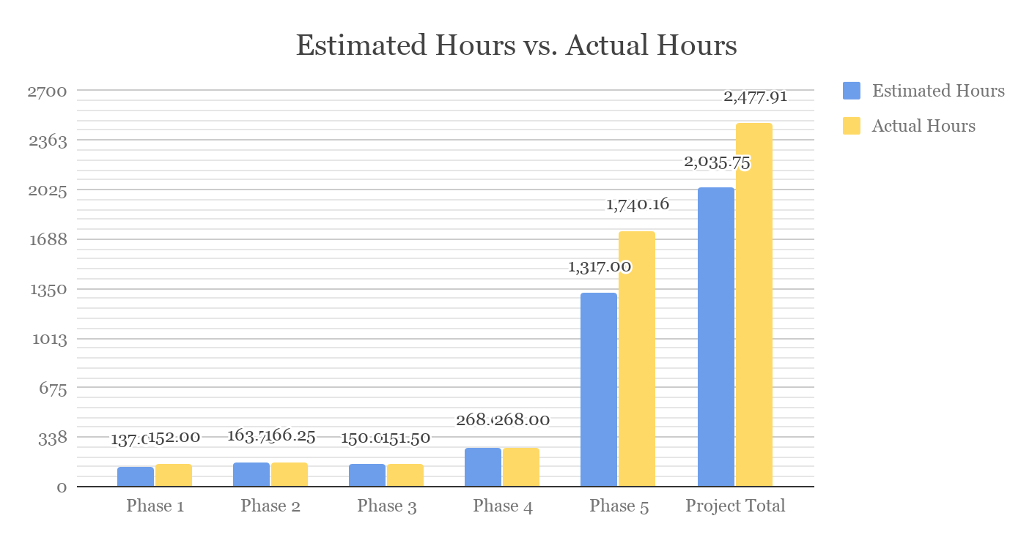
HOURS BREAKDOWN
SERVER HOURS
1448.66
LABOR HOURS
1029.25
Notes:
Kathy

Slide 8
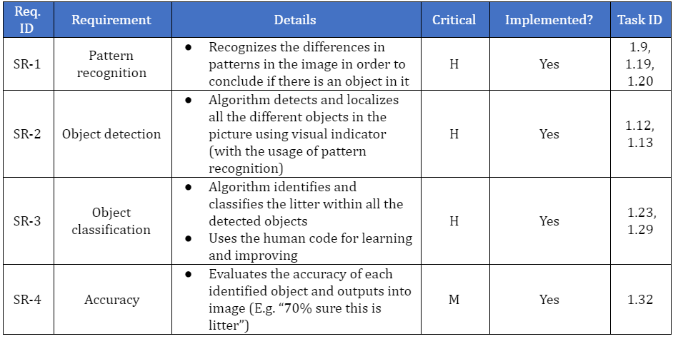
REQUIREMENTS MATRIX
Notes:
Kathy

Slide 9
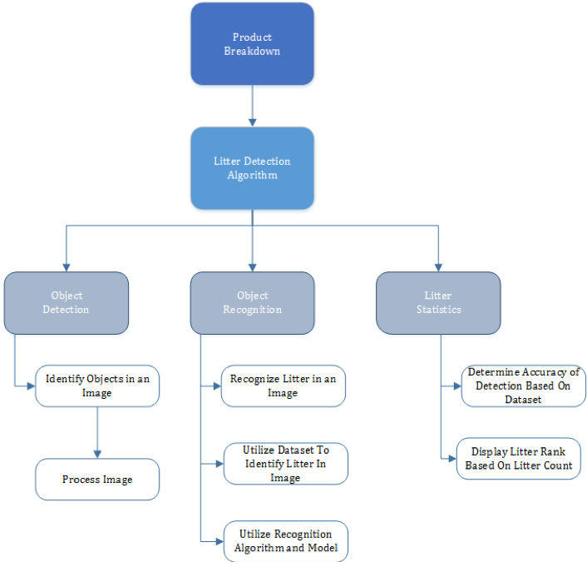
PRODUCT BREAKDOWN STRUCTURE
Notes:
Malia

Slide 10
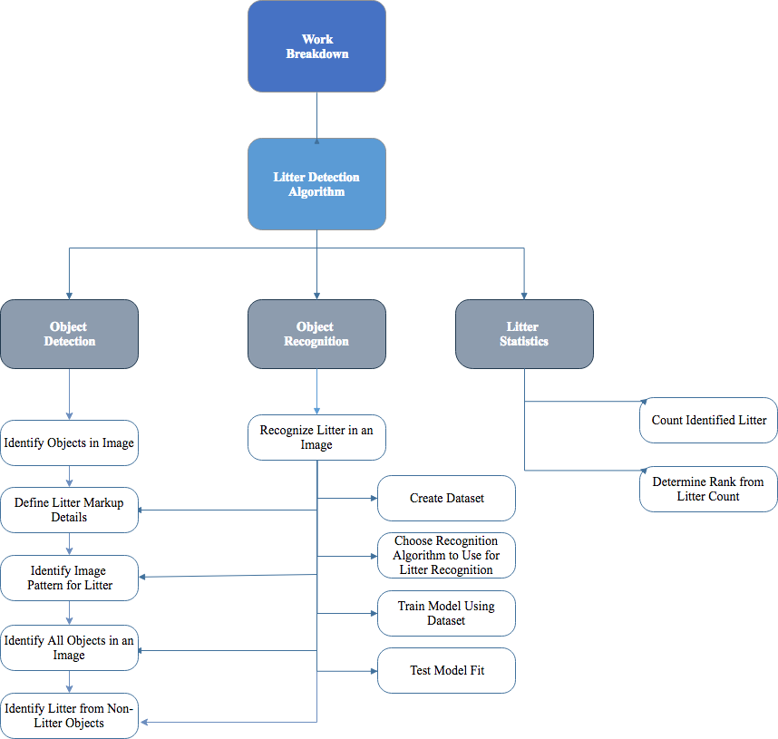
WORK
BREAKDOWN STRUCTURE
Notes:
Malia

Slide 11
ACCRUED PROJECT COST:
$25,980.46
LABOR COST
Each member charges $25/hour
Total of 6 members in group
RESOURCE COST
Upgraded EC2 Server:
T2.x2large Ubuntu @ .376¢/hour
P2.xlarge Ubuntu @ .319¢/hour
Notes:
Malia

Slide 12
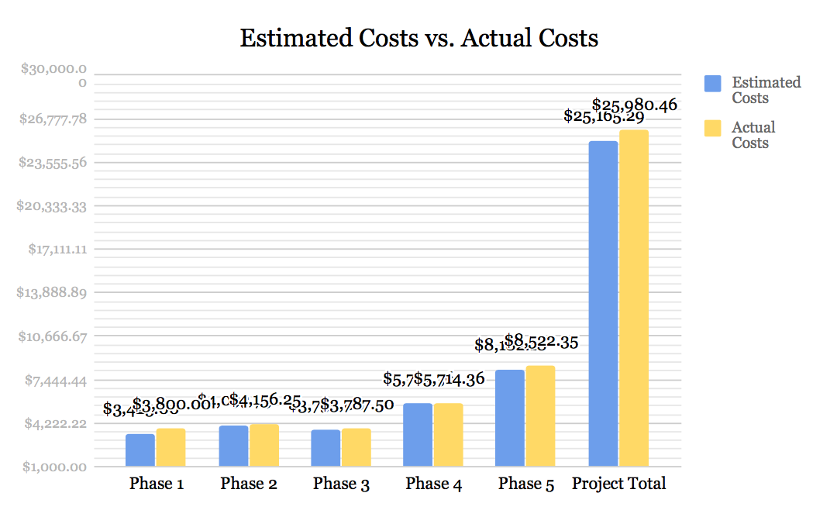
COST BREAKDOWN
SERVER COST
$249.21
LABOR COST
$25,731.25
Notes:
Malia

Slide 13
DEVELOPMENT PROCESS

Slide 14



TOOLS AND RESOURCES
ALGORITHM
Google’s open source TensorFlow API
Amazon EC2 Server used for processing power
Jupyter Notebook
DATASET
LabelImg Software
Students (“Human Coders”) from Professor Woodcock’s class
3000+ street images taken from Google Maps
Notes:
Andrew

Slide 15
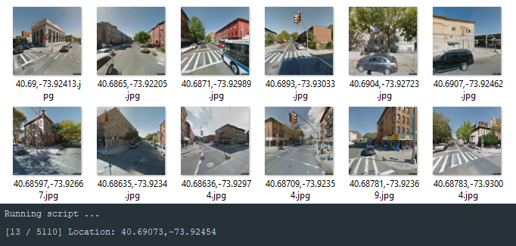
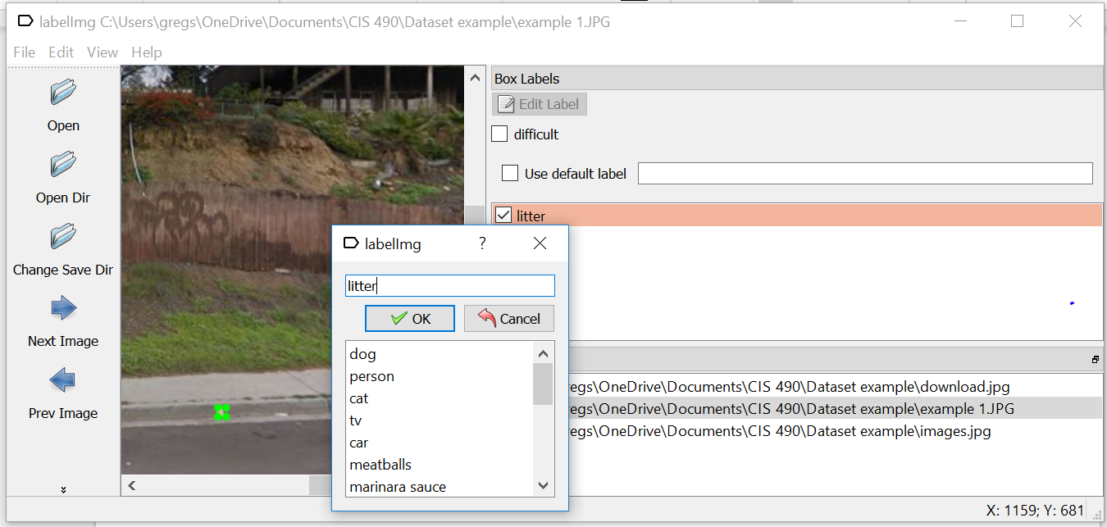
DATASET
Script to gather thousands of static street view images from Google Maps in the US
Human Code
‘Labelimg’ Software - to box and label all the litter pieces
Boxed images will be used to train Object Detection Algorithm
3000 coded images used in Dataset
Notes:
Chris

Slide 16
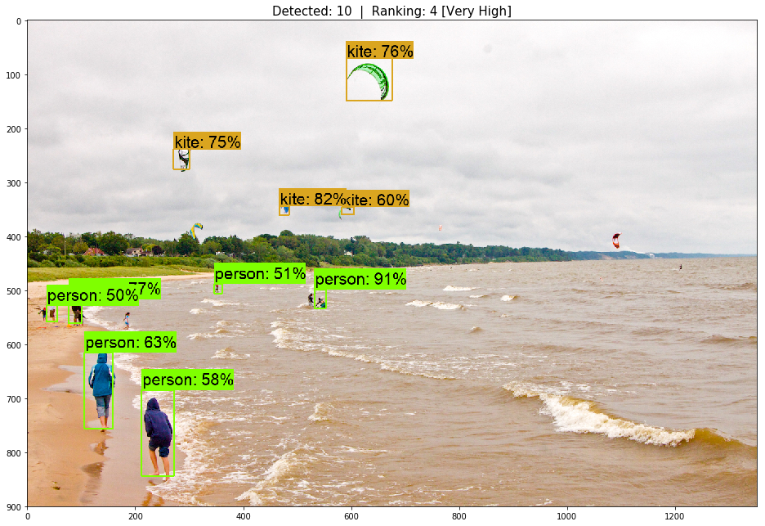
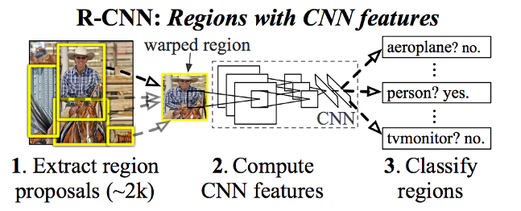
OBJECT DETECTION
Prototype I
Algorithm detects all objects found in an image
Boxes and shows accuracy
Ranking
[ 0 - 2 ] = 1 [ 3 - 5 ] = 2
[ 6 - 8 ] = 3 [ 9 + ] = 4
Objects detected through RCNN
Prototype ll
Training to specialize in detecting litter only
Notes:
Chris

Slide 17
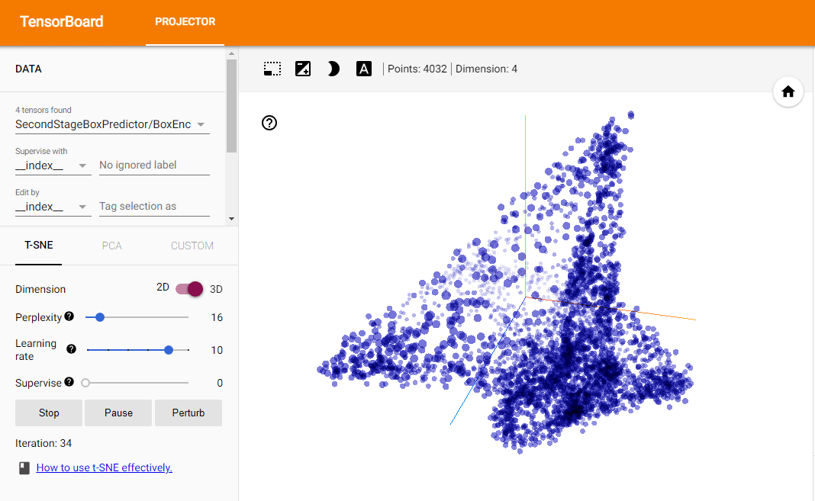
TRAINING
Trained algorithm on AWS GPU server
Dataset split into phases
80%-20% of images
Training, Testing
Algorithm training time:
~ 2 days
Regional Convolutional Neural Network (RCNN)
Notes:
Andrew

Slide 18
END PRODUCT
ACCURACY
Highest - 99%
Lowest - 50%
TYPES OF LITTER IDENTIFIED
Bottles
Cardboard
Plastic
Paper
TYPES OF LITTER NOT IDENTIFIED
Trash Cans
Trash Bags
Furniture
Notes:
Greg

Slide 19
DEMO
Notes:
Vanessa

Slide 20
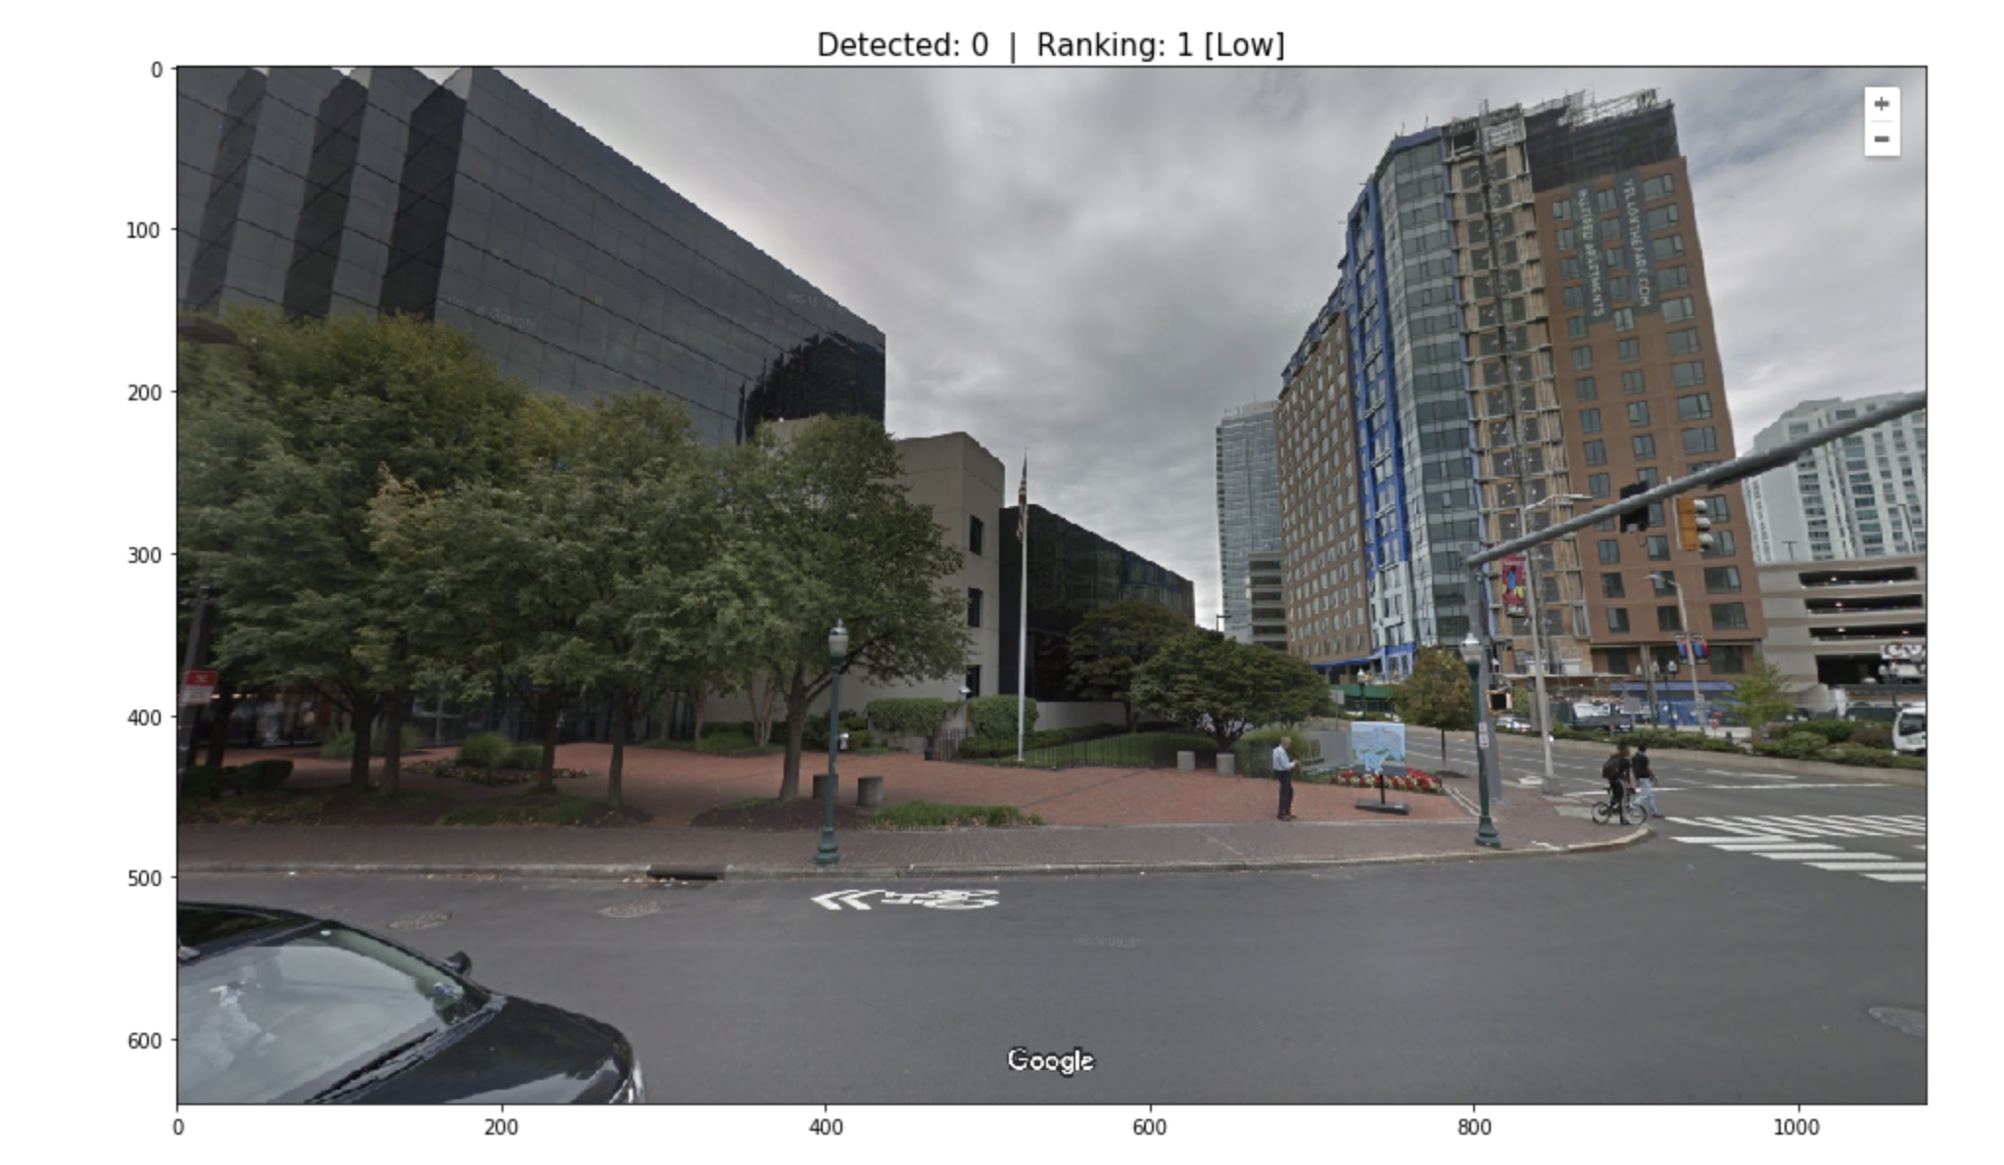
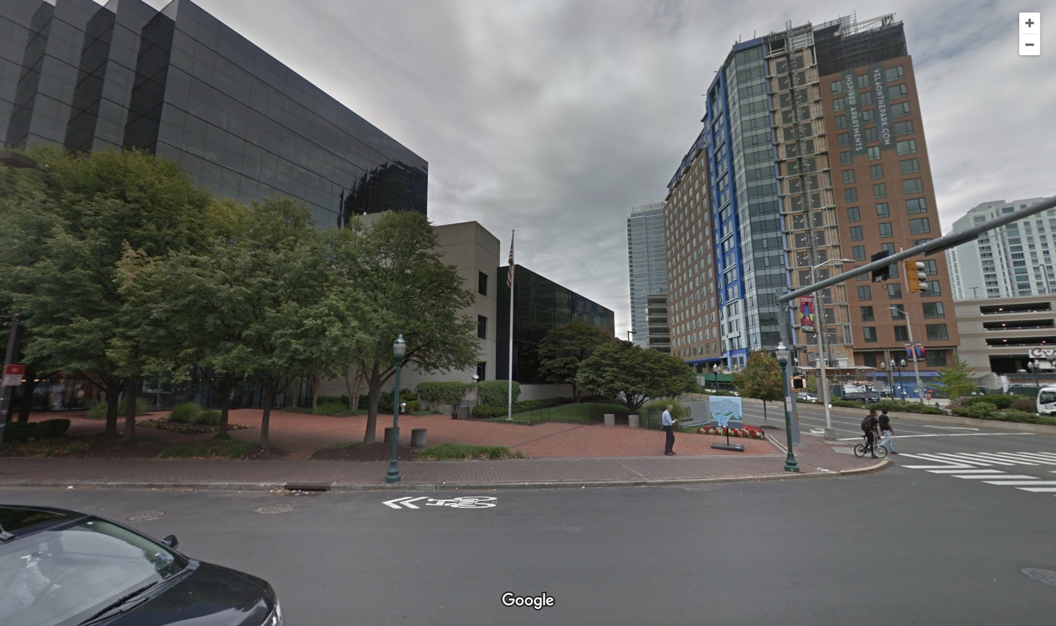
Notes:
Vanessa

Slide 21
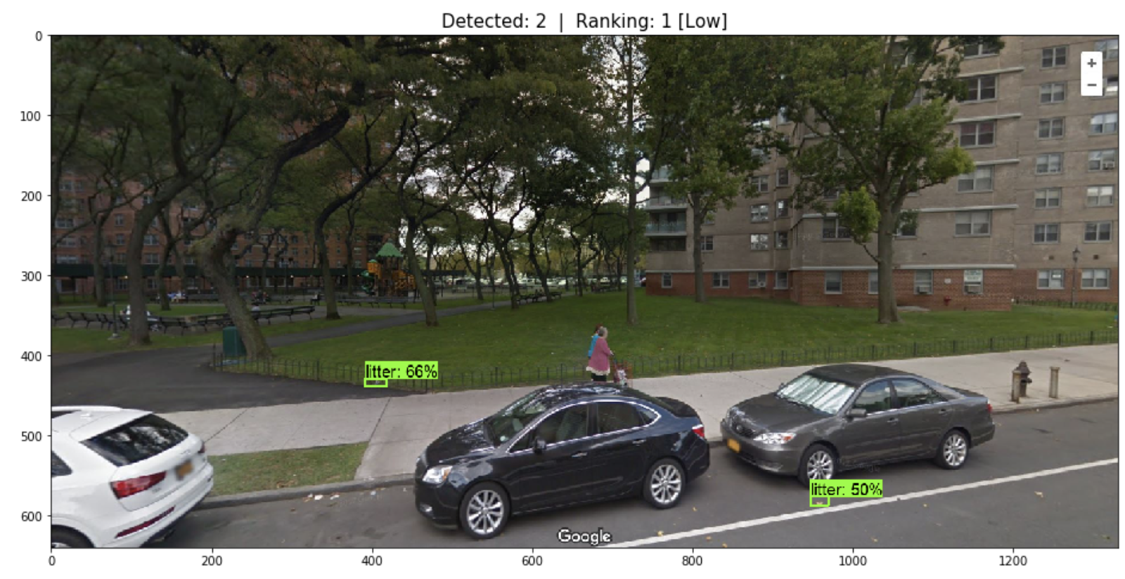
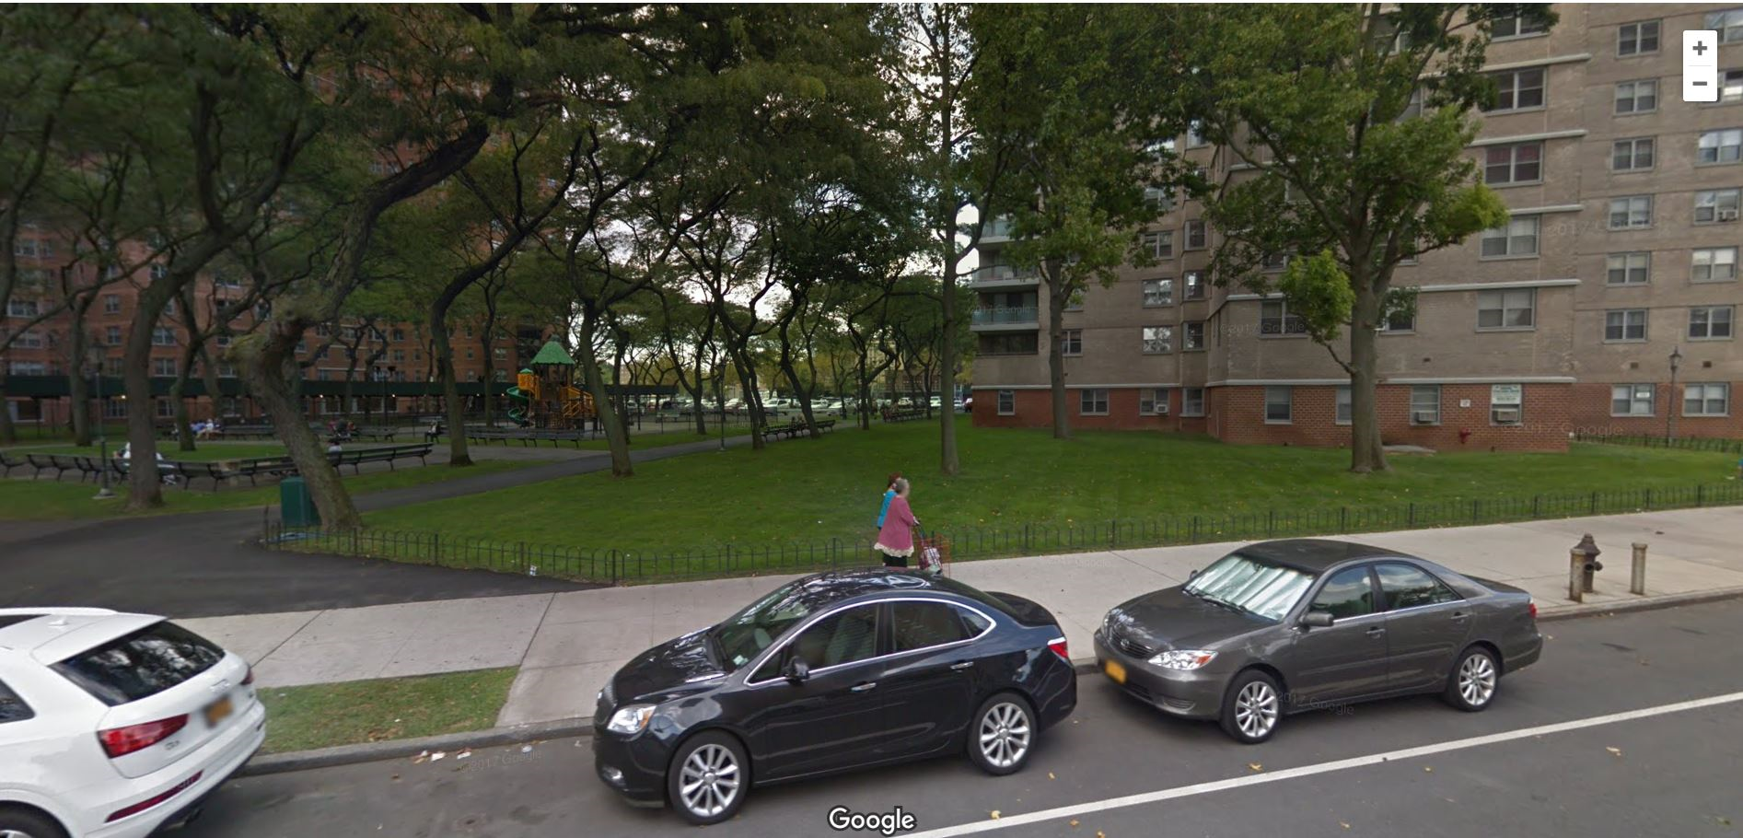
Notes:
Vanessa

Slide 22
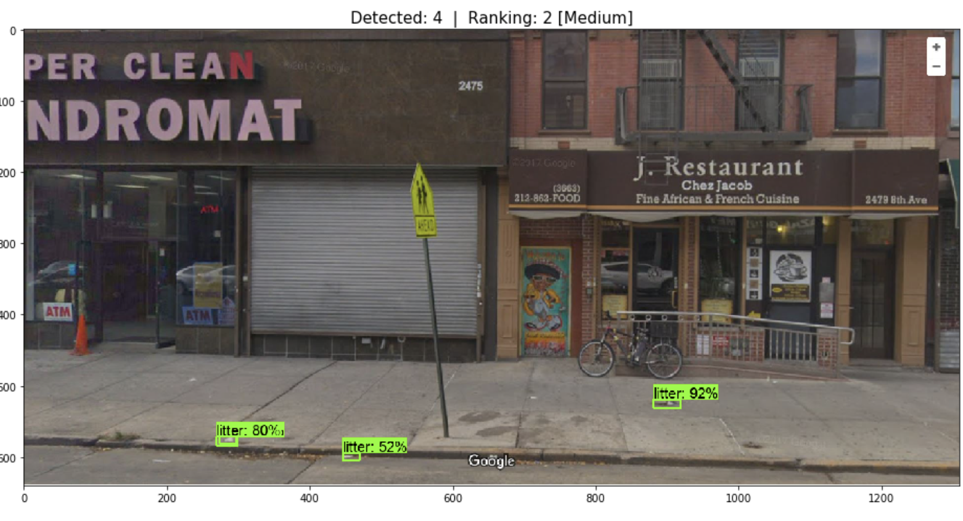
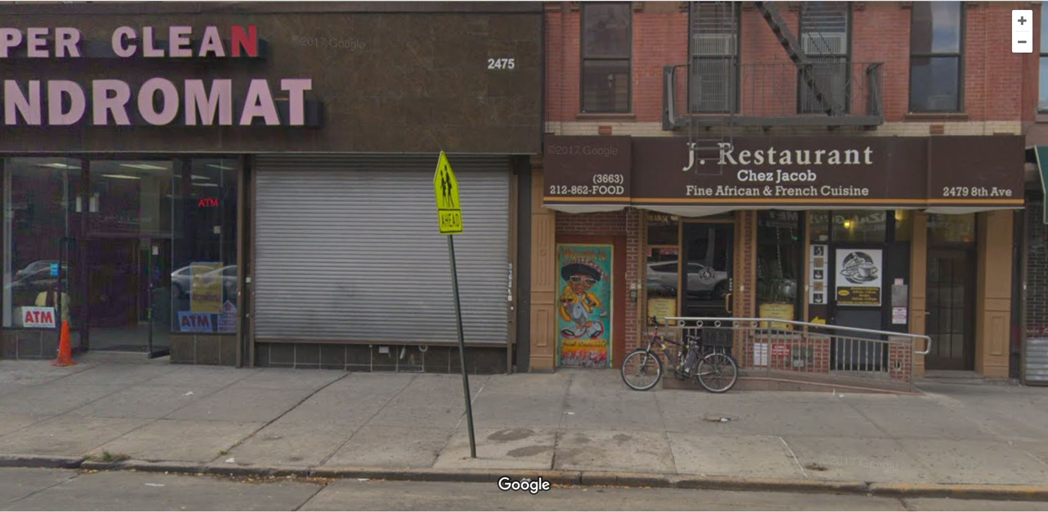
Notes:
Vanessa

Slide 23
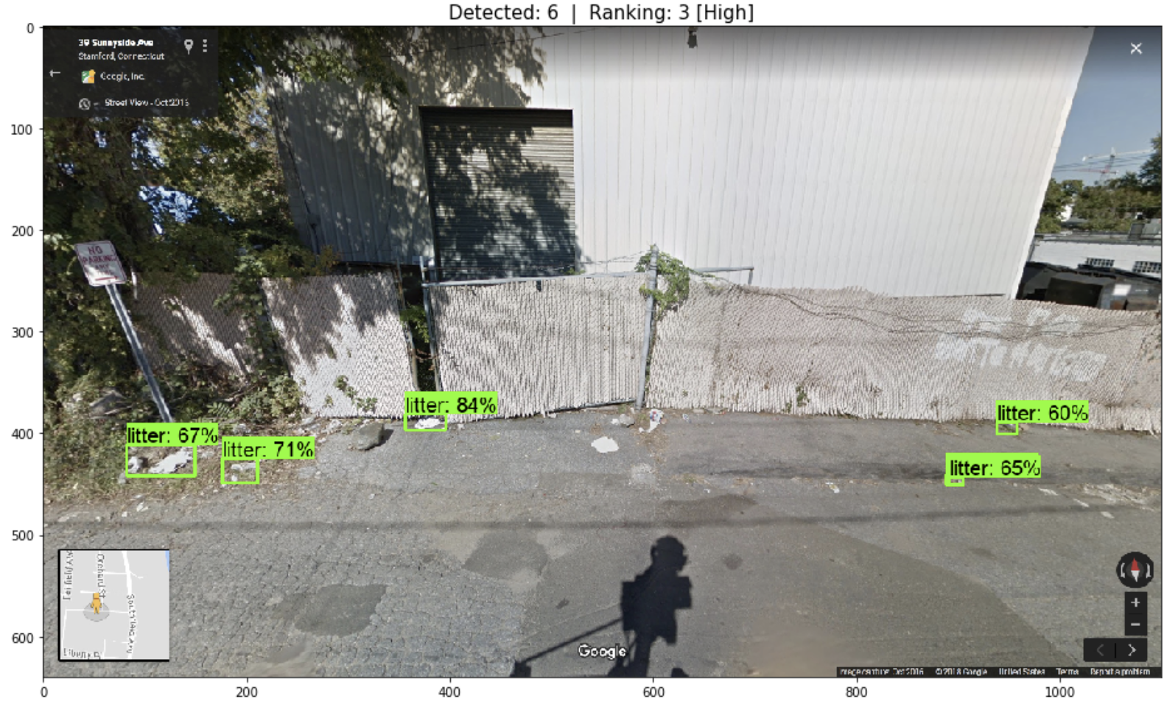
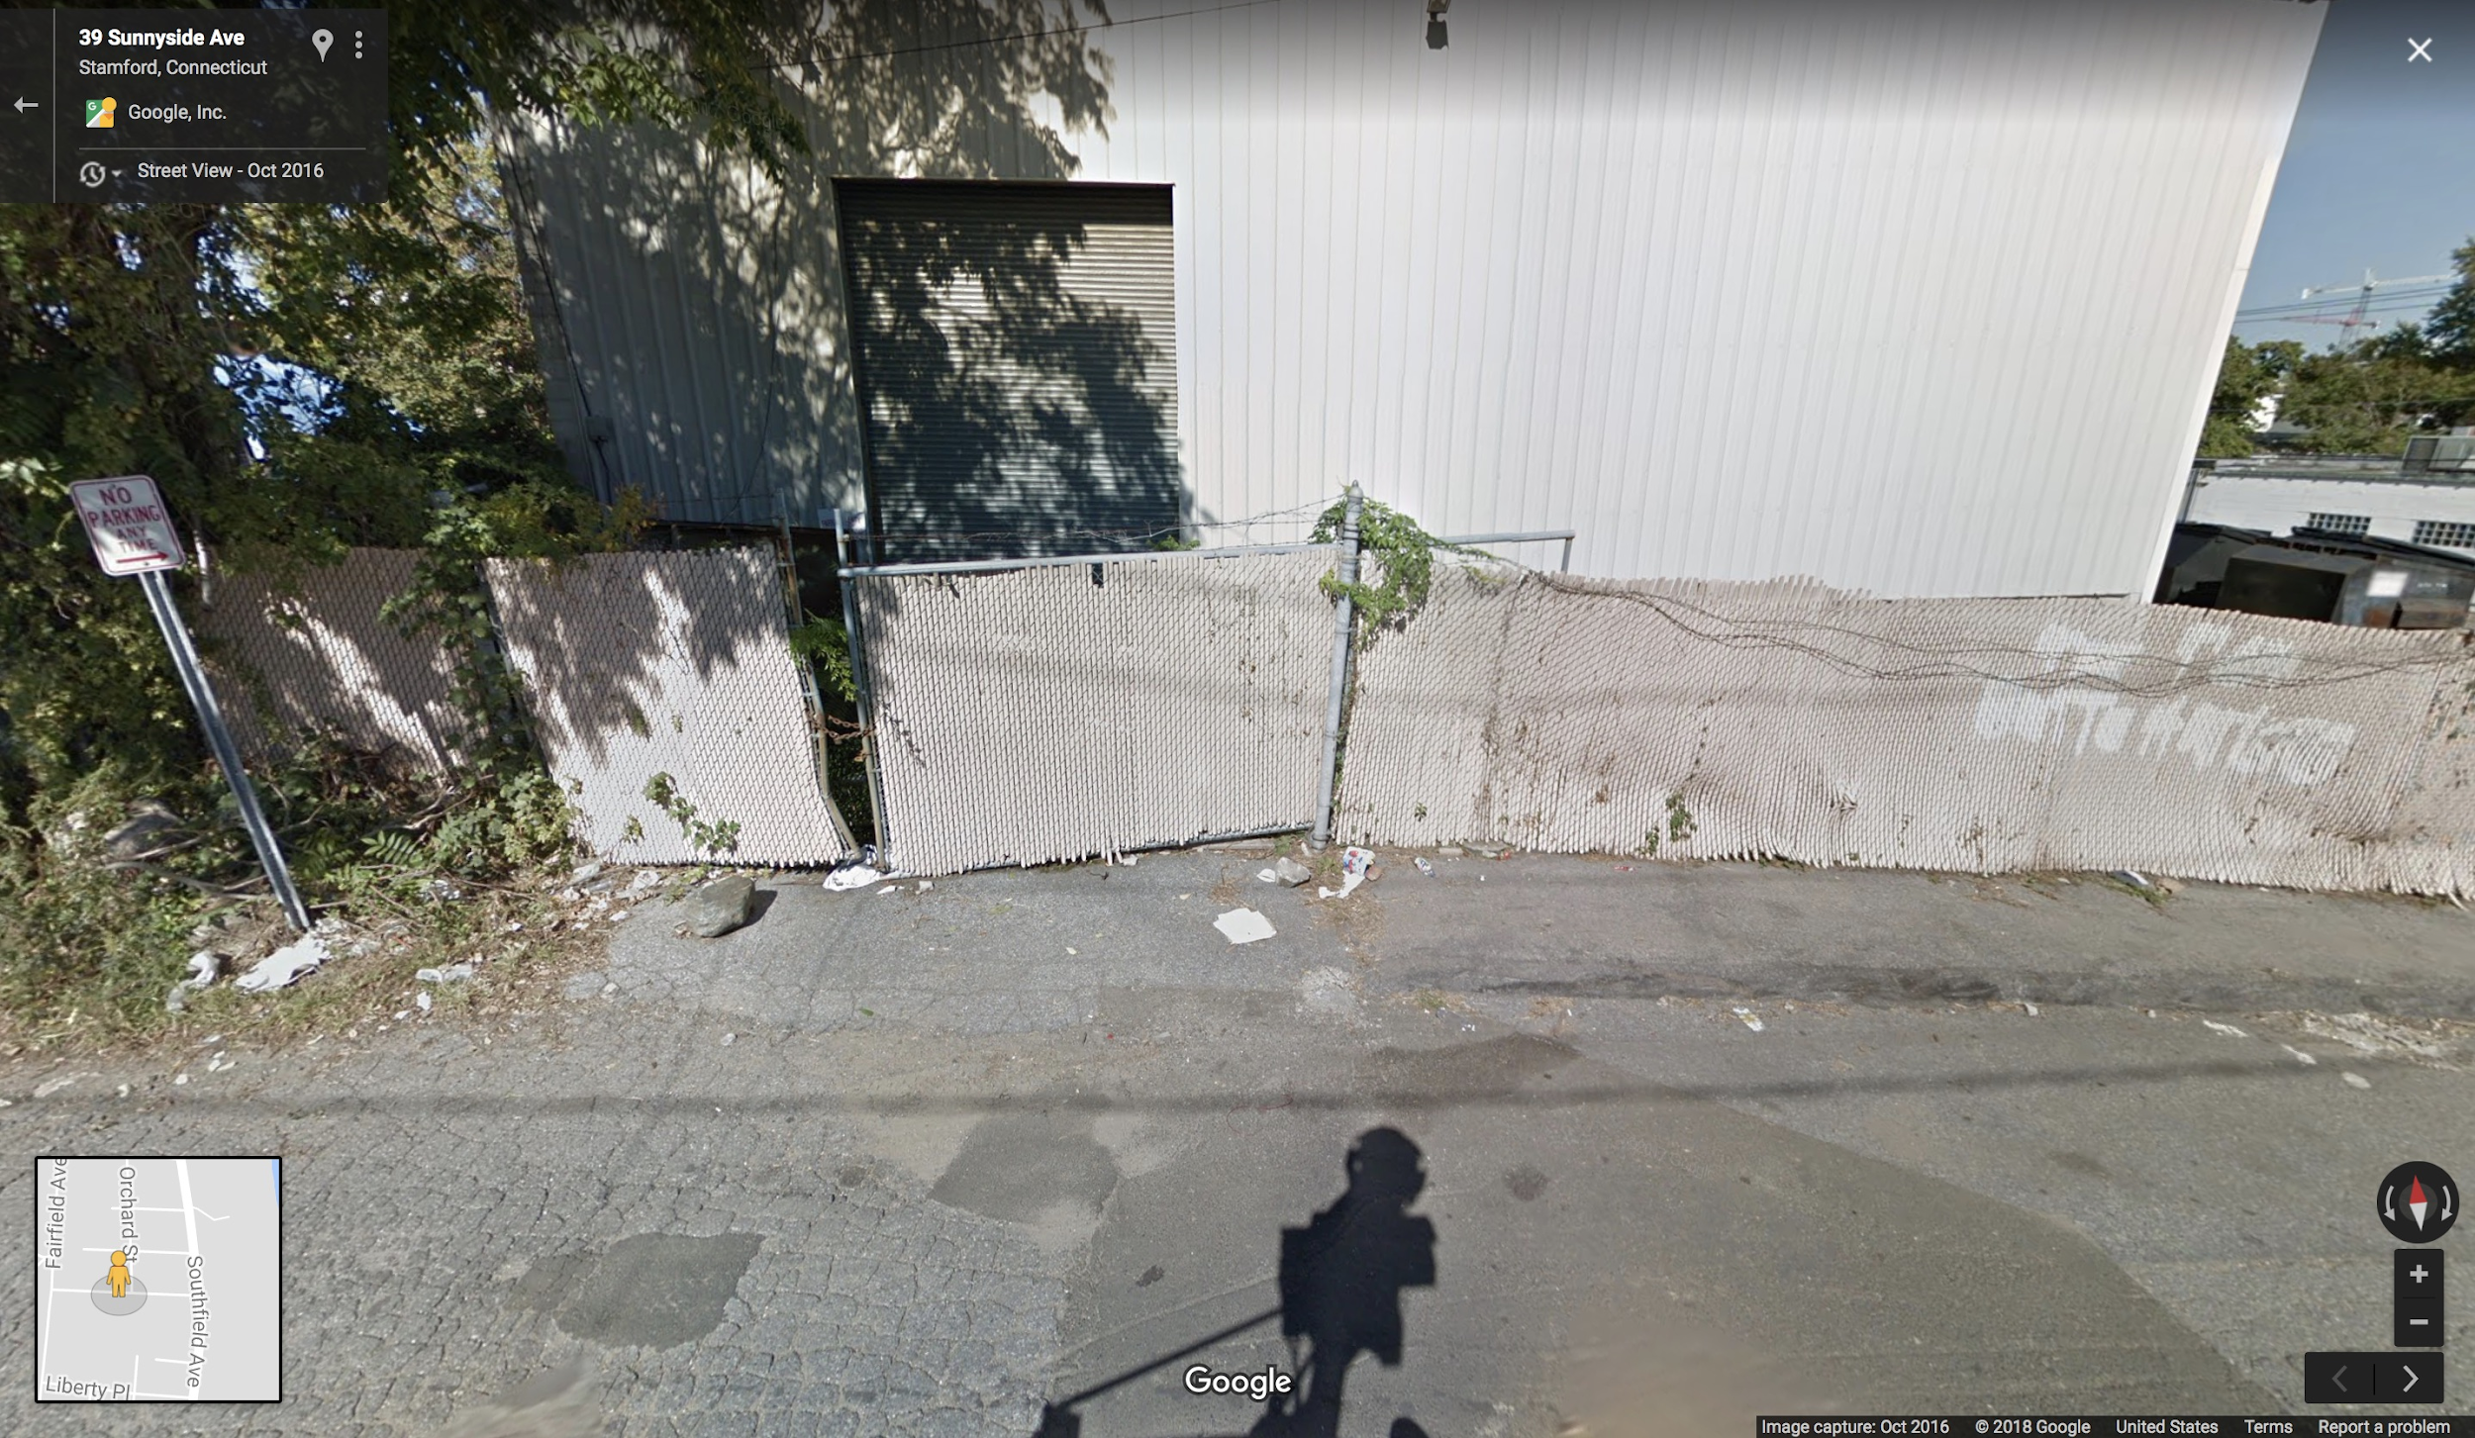
Notes:
Vanessa

Slide 24
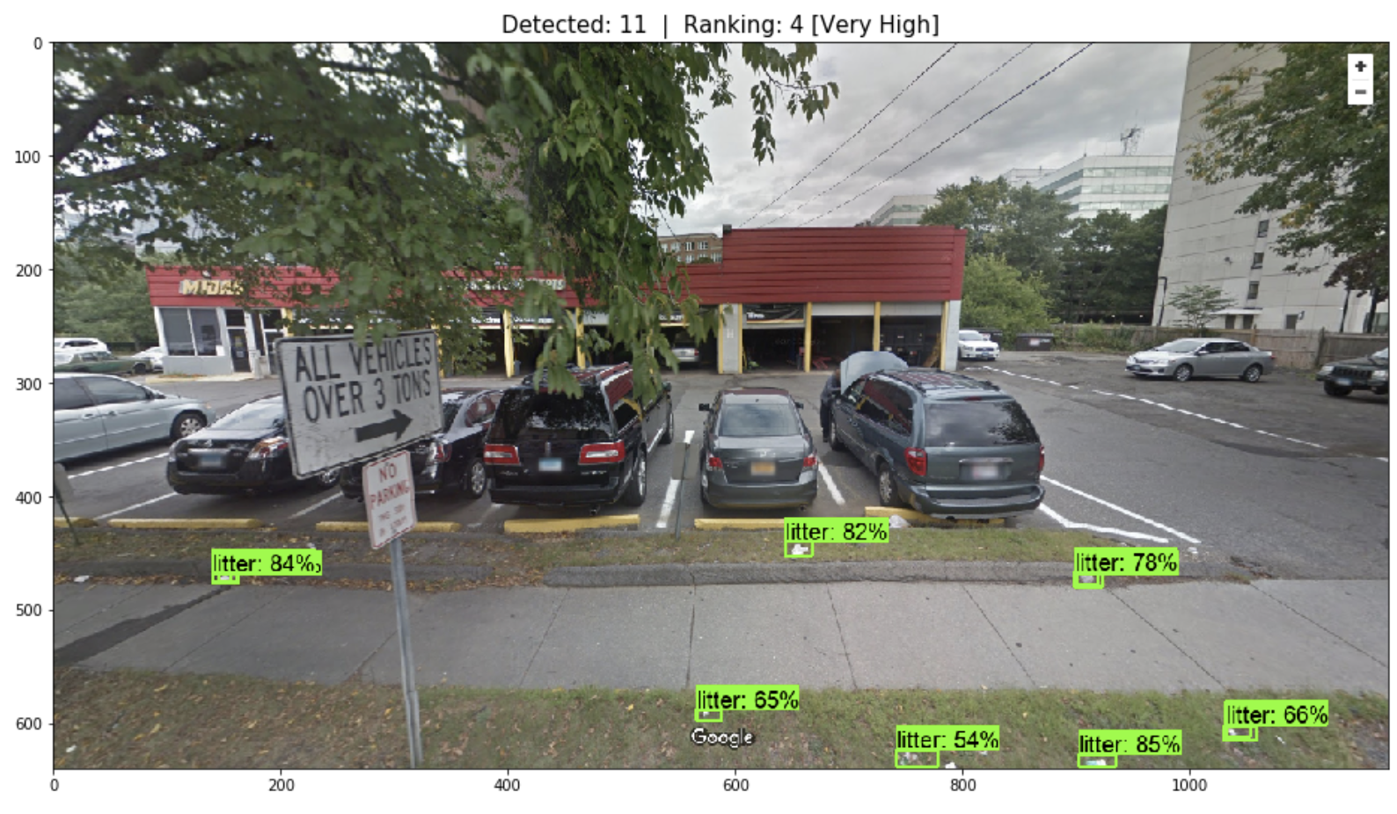
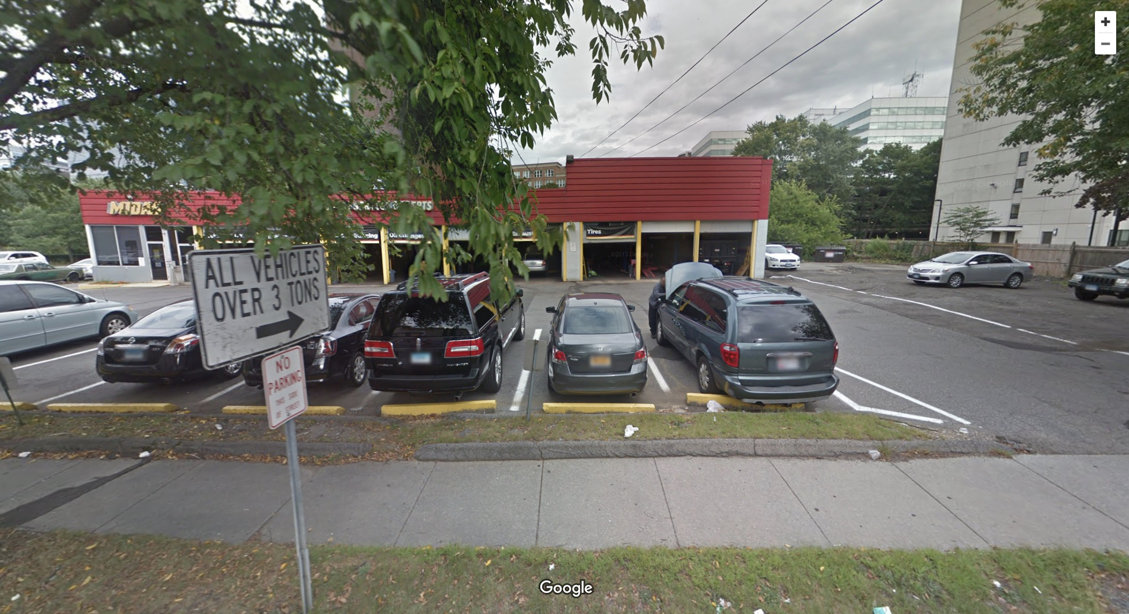
Notes:
Vanessa

Slide 25

CHALLENGES
Research AWS server Human Code Understanding Neural Networks Finalizing requirements
Notes:
Vanessa

Slide 26


FUTURE ENHANCEMENTS
Ranking system standards
Expand to detecting specific types of litter
bottles, cans, cardboard, plastic, paper, etc
User Interface
Integrated dynamically with Google Streets
Used on a national scale to highlight which areas in the US are most littered
Notes:
Vanessa

Slide 27
QUESTIONS ?
Notes:
Everyone

Slide 28
THANK YOU

